Slide 1
The slicers
The slicers

Slide 2
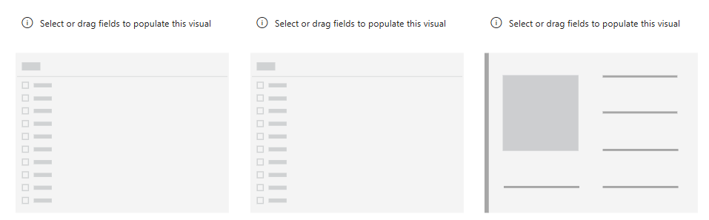
The slicers
This lab uses the Sales2019823.xls file of Excel sources
Add two Slicer visualizations to the scene and a map visual
Add two Card visualization to the scene

Slide 3


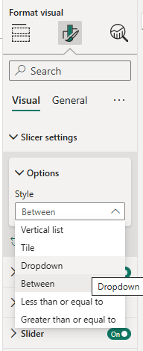

The slicers
Configure the first slicer to display Year from DimDate
Change the slicer appearance to be dropdown
1
2
3

Slide 4


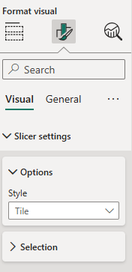
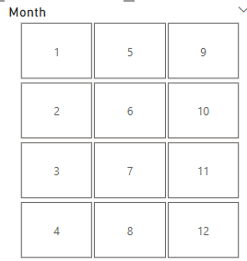
The slicers
Configure the second slicer to display Month from DimDate
Change the slicer appearance to be dropdown
1
2
3

Slide 5

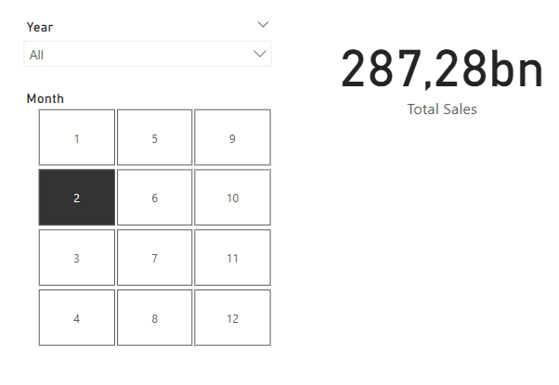
The slicers
Add the following measure to the FactSales table
Total Sales = SUMX(FactSales, FactSales[SalesQuantity]*FactSales[UnitPrice])
Then configure the Card to show Total Sales

Slide 6
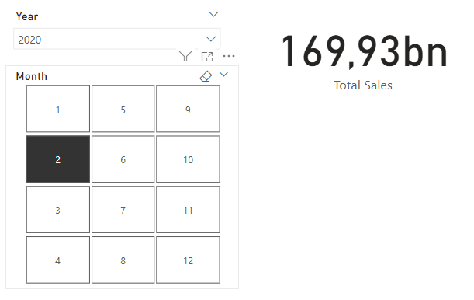
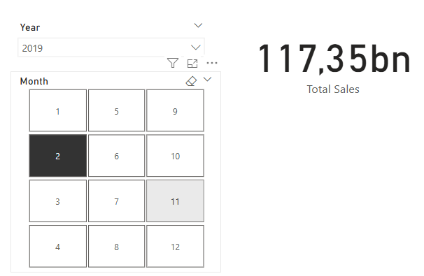
The slicers
Try to change the selections and observe the Card

Slide 7
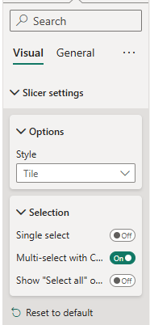
The slicers
Try to change the selection mode and observe the change
1
2
3

Slide 8
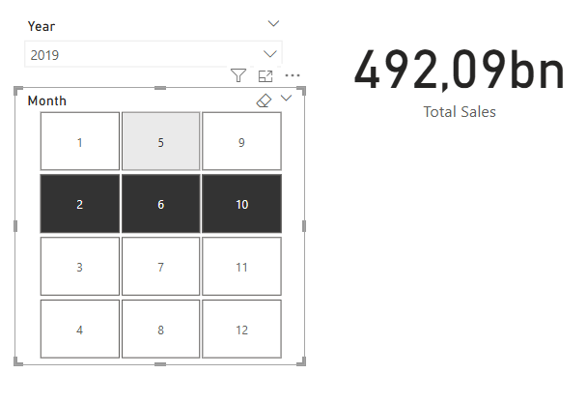
The slicers
Hold the Ctrl button and try to select multiple months

Slide 9
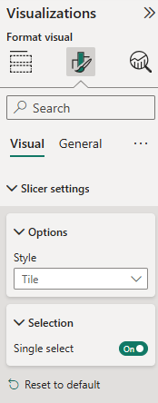
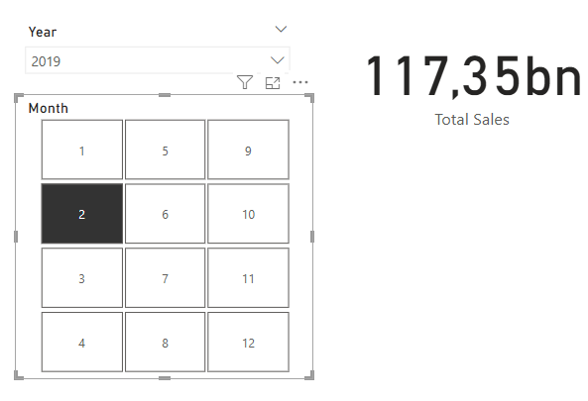
The slicers
Activate the single select and try to select multiple values
1
2
3

Slide 10
Thank you
Thank you

